Slide 1
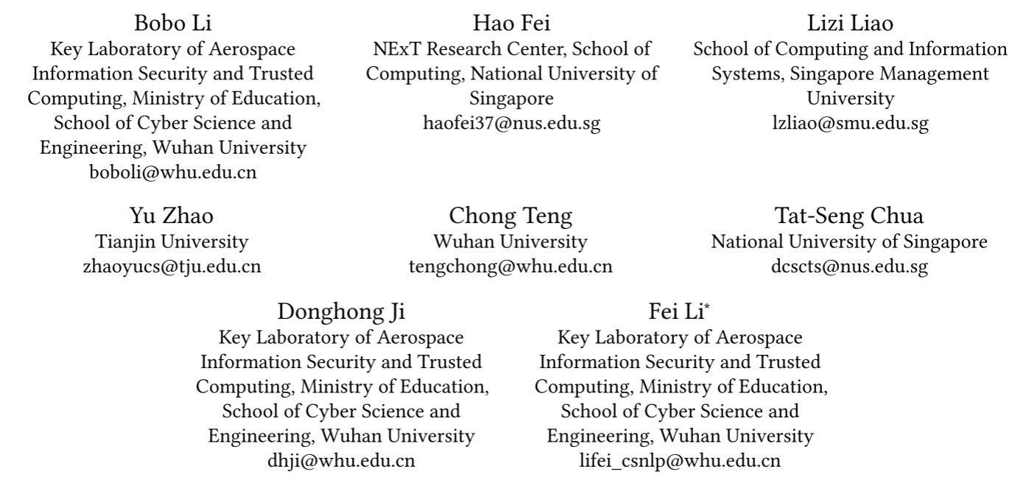
ATAI
Advanced Techniqueof Artificial Intelligence
ATAI
ChongqingUniversity _{AdvancedTechniqueof}
of Technology Artificial Intelligence
Chongqing University of
Technology
Chongqing University ^{ATAI}
_{of Technology} Advanced Techniqueof
Artificial Intelligence
Chongqing University of Technology
Chongqing University of Technology
Revisiting Disentanglement and Fusion on Modality and Context in Conversational Multimodal Emotion Recognition
Revisiting Disentanglement and Fusion on Modality and Context in Conversational Multimodal Emotion Recognition
—— MM 2023
Code:None
2024.1.28 • ChongQing
Reported by Tingting Zhang
1

Slide 2
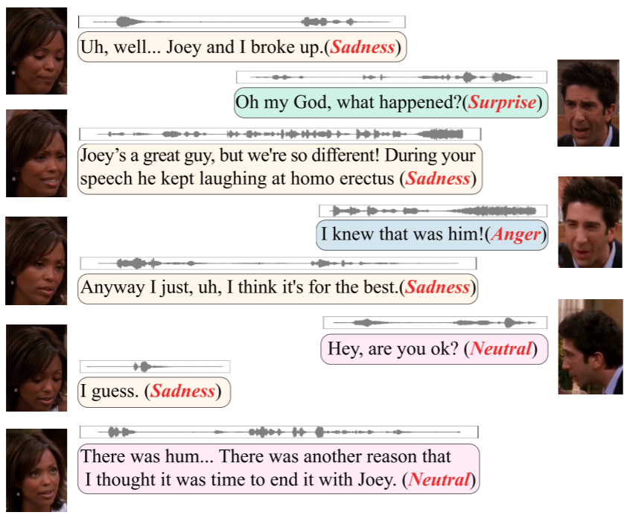
ATAI
AdvancedTechniqueof
Artificial Intelligence
ATAI
ChongqingUniversity _{AdvancedTechniqueof}
of Technology Artificial Intelligence
ChongqingUniversity of Technology
Motivation
Feature Disentanglement.
Existing models address disentanglement in individual utterances but overlook disentangling in conversational contexts.
Feature Fusion.
Previous works didn't use controllable weights, risking one modality dominating fusion and limiting overall performance.
Unnecessary to include moderate historical contexts for prediction when current multimodal signals show consistent emotion.

Slide 3
ChongqingUniversity of Technology
ATAI
AdvancedTechniqueof
Artificial Intelligence
ATAI
ChongqingUniversity _{AdvancedTechniqueof}
of Technology Artificial Intelligence
Overview

Slide 4
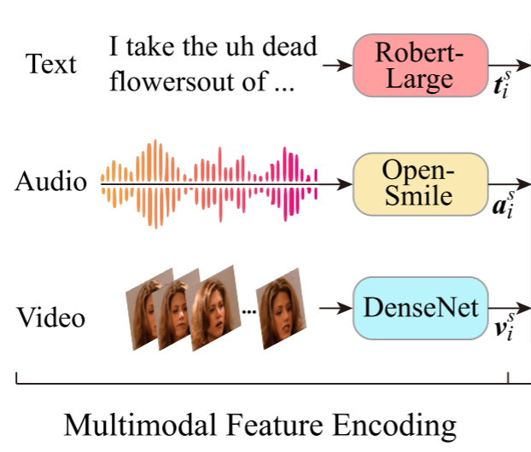
ChongqingUniversity of Technology
ATAI
AdvancedTechniqueof
Artificial Intelligence
ATAI
ChongqingUniversity _{AdvancedTechniqueof}
of Technology Artificial Intelligence
Method
1. Multimodal Feature Encoding

Slide 5
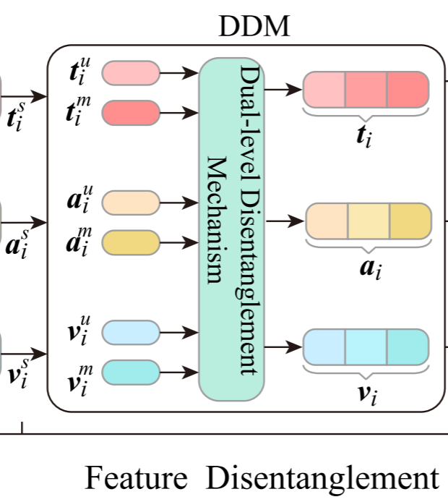
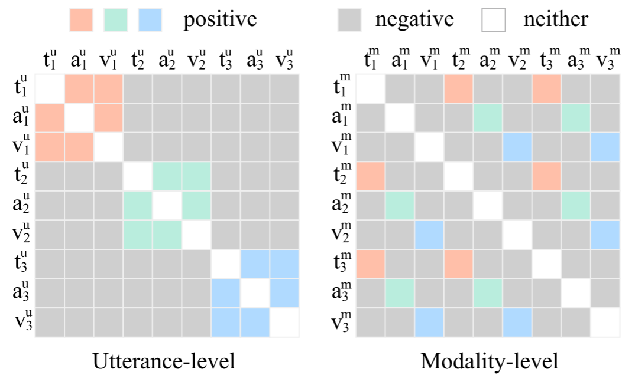
ChongqingUniversity of Technology
ATAI
AdvancedTechniqueof
Artificial Intelligence
ATAI
ChongqingUniversity _{AdvancedTechniqueof}
of Technology Artificial Intelligence
Method
2. DDM (Modality-level Representations):
DDM (Utterance-level Representations):

Slide 6
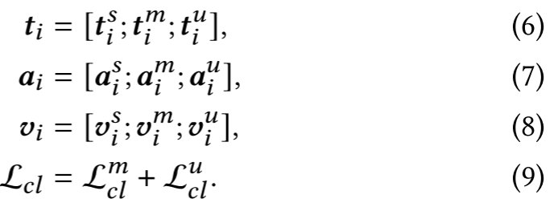
ChongqingUniversity of Technology
ATAI
AdvancedTechniqueof
Artificial Intelligence
ATAI
ChongqingUniversity _{AdvancedTechniqueof}
of Technology Artificial Intelligence
Method
2. Dual-level Disentanglement Mechanism (DDM)
Notes:
我们连接鲁棒的和相应的有偏的潜在向量，并且还连接鲁棒的和随机选择的有偏的潜在向量。

Slide 7
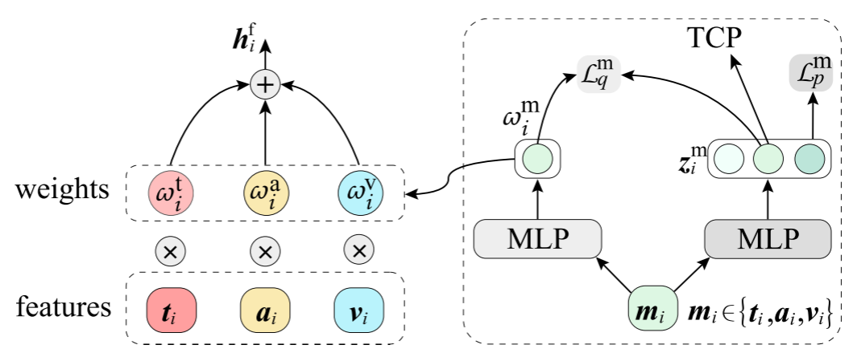
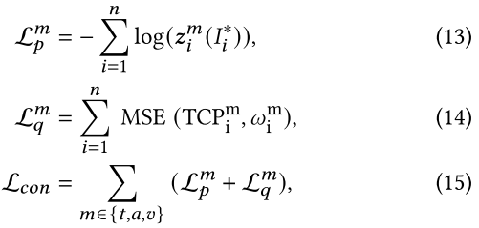
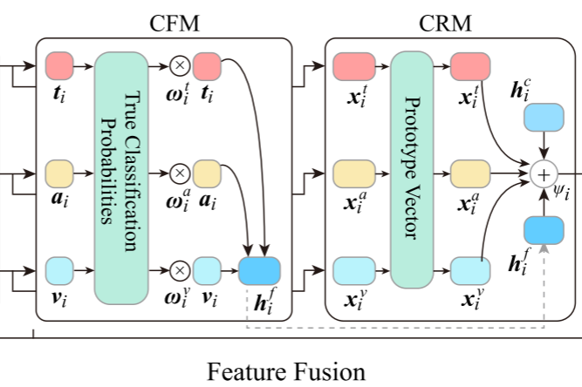
ChongqingUniversity of Technology
ATAI
AdvancedTechniqueof
Artificial Intelligence
ATAI
ChongqingUniversity _{AdvancedTechniqueof}
of Technology Artificial Intelligence
Method
3. Contribution-aware Fusion Mechanism (CFM)

Slide 8
ChongqingUniversity of Technology
ATAI
AdvancedTechniqueof
Artificial Intelligence
ATAI
ChongqingUniversity _{AdvancedTechniqueof}
of Technology Artificial Intelligence
Method
4. Context Refusion Mechanism (CRM)

Slide 9
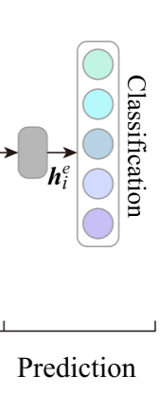
ChongqingUniversity of Technology
ATAI
AdvancedTechniqueof
Artificial Intelligence
ATAI
ChongqingUniversity _{AdvancedTechniqueof}
of Technology Artificial Intelligence
Method
5. Prediction and Learning

Slide 10
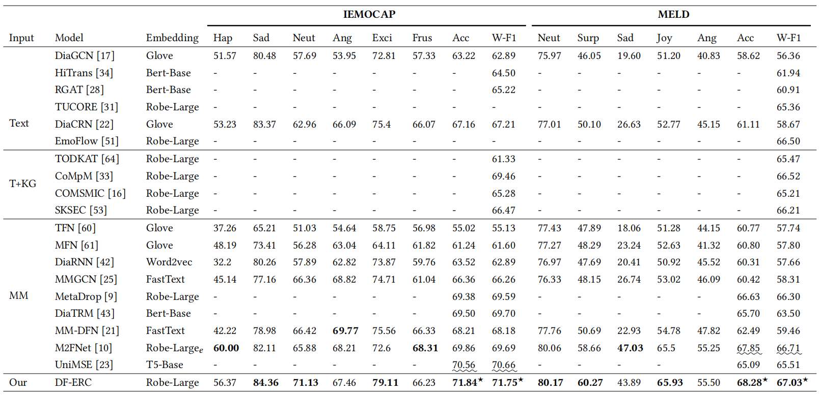
ATAI
AdvancedTechniqueof
Artificial Intelligence
ATAI
ChongqingUniversity _{AdvancedTechniqueof}
of Technology Artificial Intelligence
ChongqingUniversity of Technology
Experiments

Slide 11
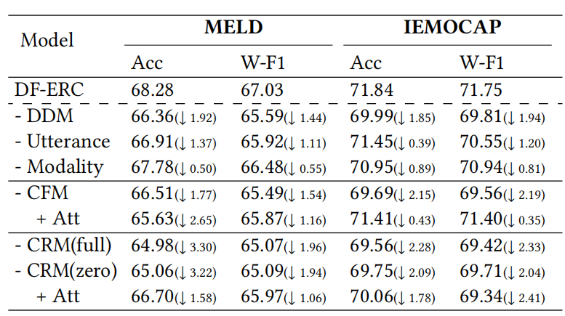
ATAI
AdvancedTechniqueof
Artificial Intelligence
ATAI
ChongqingUniversity _{AdvancedTechniqueof}
of Technology Artificial Intelligence
ChongqingUniversity of Technology
Experiments

Slide 12
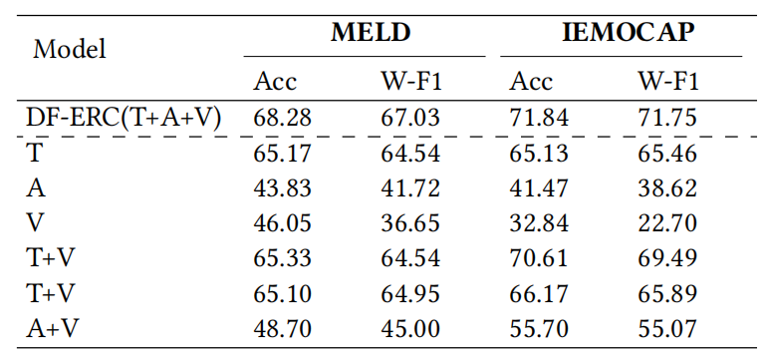
ATAI
AdvancedTechniqueof
Artificial Intelligence
ATAI
ChongqingUniversity _{AdvancedTechniqueof}
of Technology Artificial Intelligence
ChongqingUniversity of Technology
Experiments

Slide 13
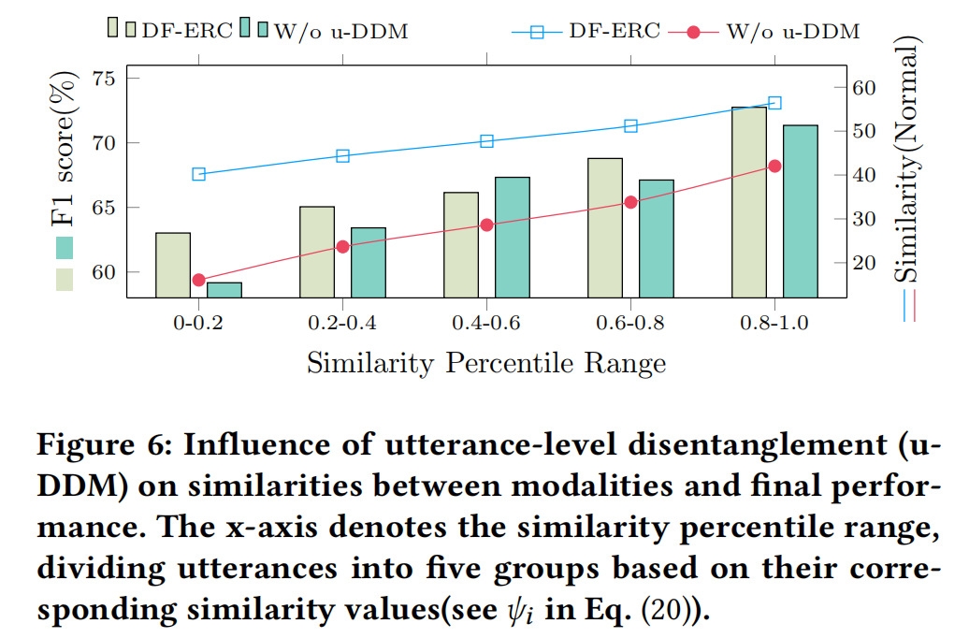
ATAI
AdvancedTechniqueof
Artificial Intelligence
ATAI
ChongqingUniversity _{AdvancedTechniqueof}
of Technology Artificial Intelligence
ChongqingUniversity of Technology
Experiments

Slide 14
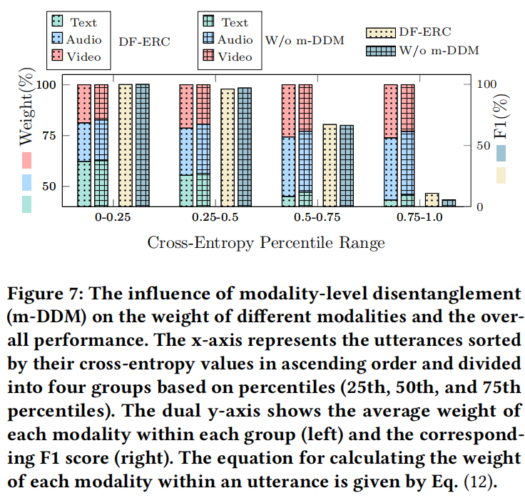
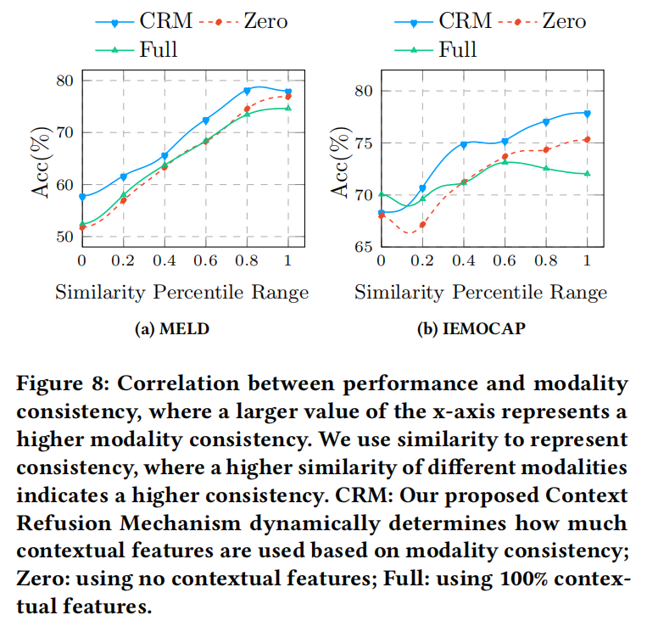
ATAI
AdvancedTechniqueof
Artificial Intelligence
ATAI
ChongqingUniversity _{AdvancedTechniqueof}
of Technology Artificial Intelligence
ChongqingUniversity of Technology
Experiments

Slide 15
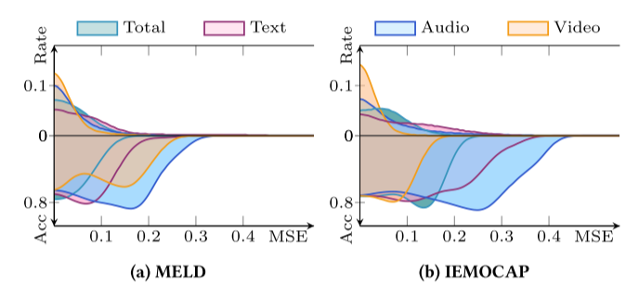
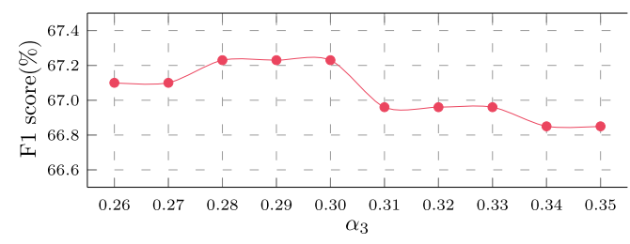
ATAI
AdvancedTechniqueof
Artificial Intelligence
ATAI
ChongqingUniversity _{AdvancedTechniqueof}
of Technology Artificial Intelligence
ChongqingUniversity of Technology
Additional Experiment

Slide 16
ChongqingUniversity of Technology
ATAI
AdvancedTechniqueof
Artificial Intelligence
ATAI
ChongqingUniversity _{AdvancedTechniqueof}
of Technology Artificial Intelligence
Thanks!

